Slide 1
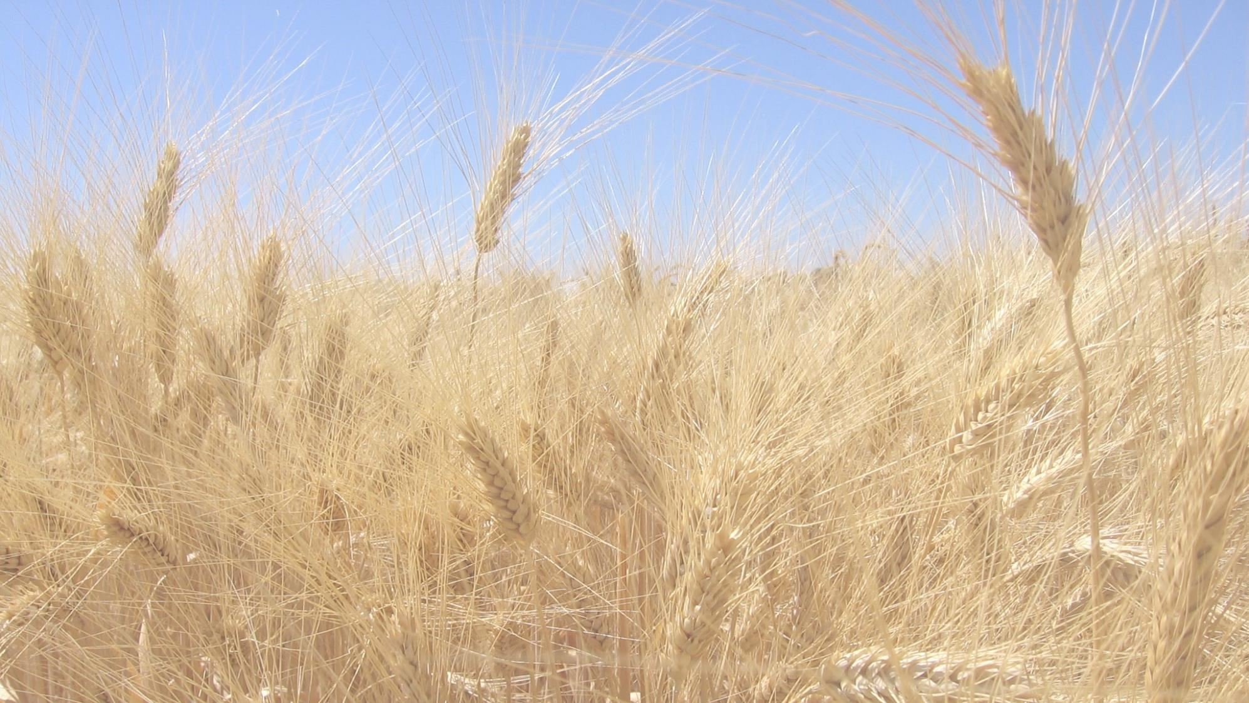

Breeding for improved wheat quality and nutritional value
University of California, Davis
Notes:
The question of the relevance of plant sciences research for food security has been recently endorsed by the $75M funding of o basic plant science research program by the Howard Hughes Medical Institute, which fund only high impact basic research. This program made a statement of the importance of wheat basic research by funding my wheat research program n

Slide 2
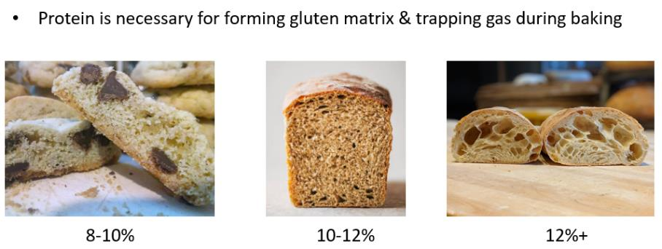
Grain protein content
Notes:
Premium price for protein: $22 per ton

Slide 3
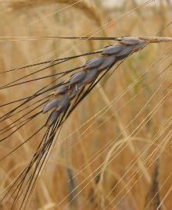
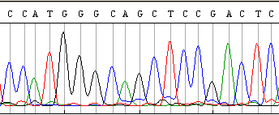
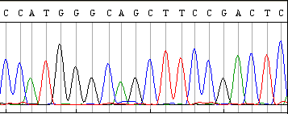
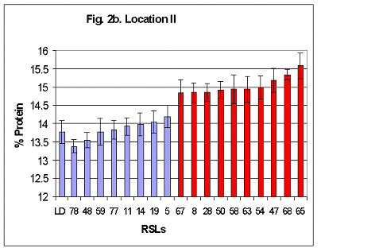
Identification of GPC-B1 causal gene
Wild wheat with high GPC
Red: piece of wild wheat
Precise genetic stocks + Replicated field experiments
A
Field experiment Davis 10 reps.
A
RSL#65 x LDN
B
B
1
1
2 3 4 5 6 7
2 3 4 5 6 7
Chr. 6BS
Precise mapping using 9000 segregating chromosomes
8 kb
ucw71
Xuhw89
gwm508
4.7
NAC1 transcription factor
0.9
Nor-B2
ucw64
1.5
Gpc-6B1
1.2
ucw65
Wild
Functional
3.0
0.9
ucw66
gwm193
Cultivated
Non-functional!
Science 2006, 314:1298

Slide 4
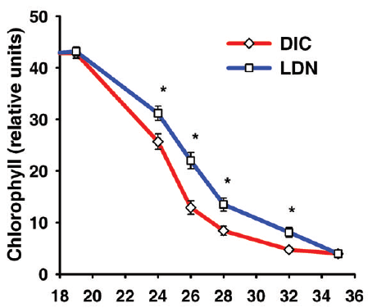
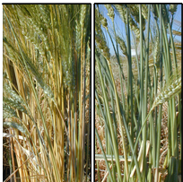
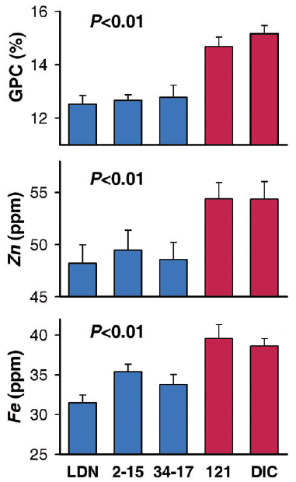
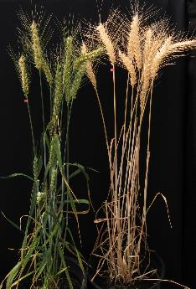
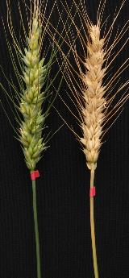
GPC-B1 encodes a transcription factor that regulates senescence and nutrient transport to the grain
Non-functional Functional
cultivated wild
RNAi
not functional
WT
Lines with the functional wildtype
GPC-B1 allele translocate more
nutrients from leaves to grain by regulating multiple transporters
RNAi WT RNAi WT
Notes:
RNAi: 50% chlorophyll los 24 d later and peduncles turned yellow >30 d later

Slide 5
Functional Gpc-B1 allele increases protein, Fe & Zn
Control NIL
HEXAPLOID
Anza, RSI5, Yecora Rojo
TETRAPLOID
Kofa, UC1113
GPC NIL
g kg⁻¹
g kg⁻¹
N = 60 (per NIL)
Fe
+11.2%
Fe
+20.3%
We introgressed GPC-B1 into 6 bread and 3 durum wheats and evaluated them in the field 2 years in 3 locations
g kg⁻¹
Grain Protein Concentration
148
144
***
140
***
136
Zn
Zn
+2.5%
+2.9%
132
128
124
120
Control
GPC
Control
GPC
Bread wheat
Pasta
In replicated field experiments, lines carrying the functional GPC-B1 allele showed significant increases in grain protein, iron and zinc

Slide 6
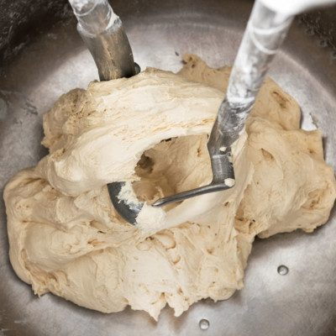
Protein quality and gluten strength

Slide 7
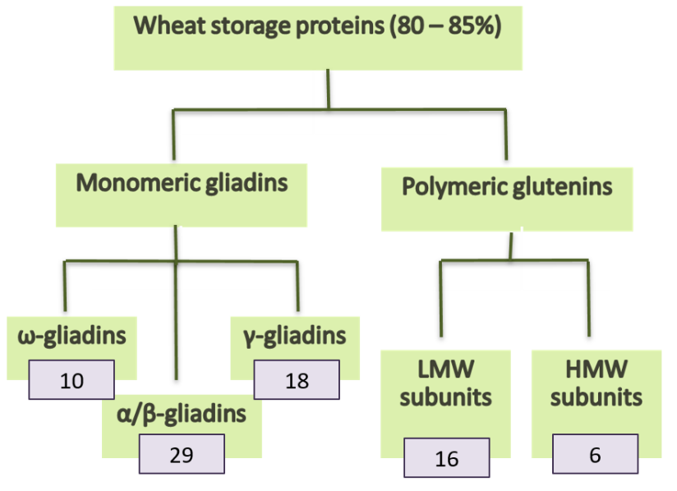
Wheat storage proteins
Wheat BMQ depends on the amount and quality of storage proteins.
Gluten refers to the viscoelastic matrix of proteins mixed in water
Polymeric glutenins are critical for gluten elasticity and strength.
Monomeric gliadins may affect extensibility and viscosity

Slide 8
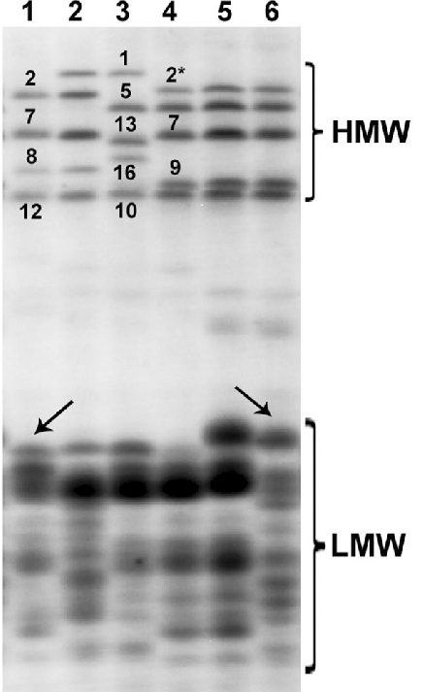
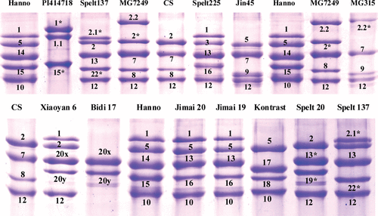
High molecular weight glutenins (HMW)
SDS-PAGE
(sodium dodecyl sulfate)
HMW glutenins are encoded by 2 linked genes on chromosome arms 1AL, 1BL and 1DL (x =80-100 kDa and y= 60-80 kDa)
Different HMW glutenin alleles have known effects on gluten strength and loaf volume:
Glu-A1= Subunit x only= 1 = 2* >> null allele (bad)
Glu-B1= Subunits x + y = 7BxOE & 17+18 ≥ 13+16, 7+8, 7+9 >6+8 or 7 (bad)
GluD1= Subunits x + y = 5+10 >> 2+12 (bad)
Chr 1
60k to 100k
30k to 50k
LMW
HMW
There are now good DNA markers for these different alleles
Notes:
Ay is not functional and Ax sometimes not functional

Slide 9
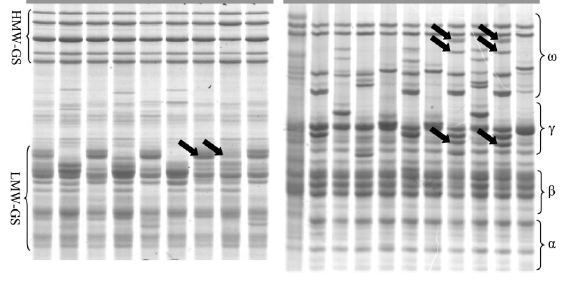
Low molecular weight glutenins (LMW)
Isogenic lines with identical HMW glutenins and α/β gliadins
Bonafede et al. 2015. J. of Cereal Sci.
LMW glutenins are intermixed with γ and ω gliadins in complex loci on chromosome arms 1AS, 1BS and 1DS
Linked LMW glutenin and γ and ω gliadins patterns can be used as markers for the different alleles.
Linked DNA markers are also used (e.g. SSR)
Glu-A3/Gli-A1= b ≥ f ≥ c > d ≥ g > e (null bad)
Glu-B3/Gli-B1= c > d > b, g, i_{man} >> a, h, i_{c} , j
GluD3/Gli-D1= b & c ≥ d, l ≥ a, e, f, g
Limitation: order varies for different quality parameters
Bonafede et al. 2015. J. of Cereal Sci. 62:143-150
Guzman, et al. 2022 Field Crops Research 284: 108585
SDS-PAGE (HMW & LMW) ACID-PAGE (gliadins)
Ch.
1L
Ch.
1S
Ch.
1S
Ch.
1S
α
Ch.
6S

Slide 10
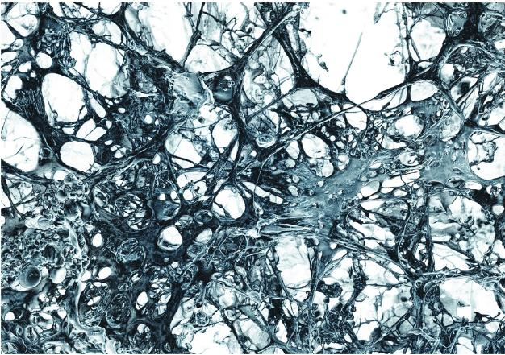
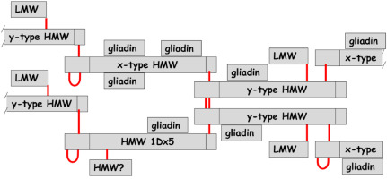

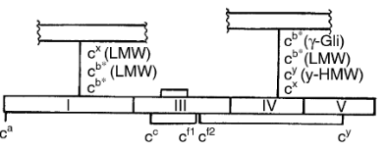
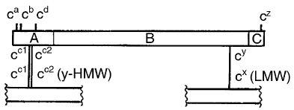
Gluten models
Gluten forms a three‐dimensional network stabilized by both covalent and noncovalent forces that traps CO₂ produced by yeast respiration.
Inter-chain disulphide bonds between cysteines (C=C) stabilize the polymers and contribute to elasticity.
HMW‐GS associated with good quality (1Dx5 & 1Bx7) > cysteine residues than poor‐quality subunits (1Dx2 & 1Bx20). Higher cross-link may contribute to increased elasticity.
Gliadins are mainly associated to the gluten polymer by H bonds.
A minor portion of gliadins with odd number of cysteines can act as terminator of glutenin polymerization (“aggregated gliadins”)
Size of the “glutenin macropolymer” (GMP) correlate with BMQ.
Continuous 3‐D network stabilized by covalent (red) and noncovalent forces (H-bonds). Hypothetical model
αGLI
Most gliadins have only intramolecular C=C
HMW
LMW
LMW and HMW glutenins have intermolecular C=C
Notes:
β-mercaptoethanol (BME) is used to eliminate the disulphide bonds (is a potent reducing agent)
A minor portion of gliadins have an odd number of cysteines due to point mutations and are linked together or to glutenins. They appear either in alcohol-soluble oligomers in the gliadin fraction or in the alcohol-insoluble glutenin polymers. This form of gliadins is proposed to act as terminator of glutenin polymerization
LMW-GS contain eight cysteines; six residues are in positions homologous to a/b- and g-gliadins, and therefore, are proposed to be linked by intrachain disulphide bonds (Fig. 1). Two additional cysteine residues unique to LMW-GS are located in Sections I and IV. They are not able to form an intrachain bond, probably for steric reasons. Consequently, interchain disulphide bonds

Slide 11
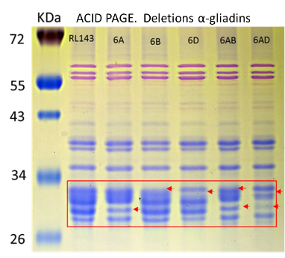
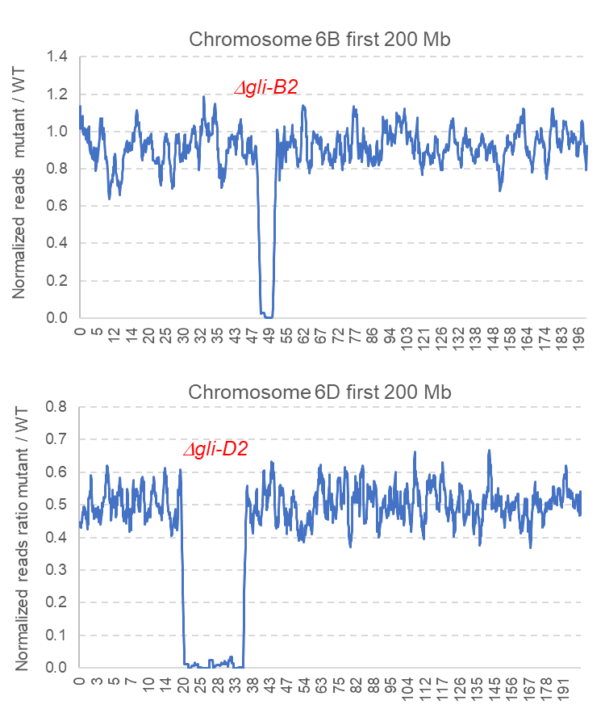
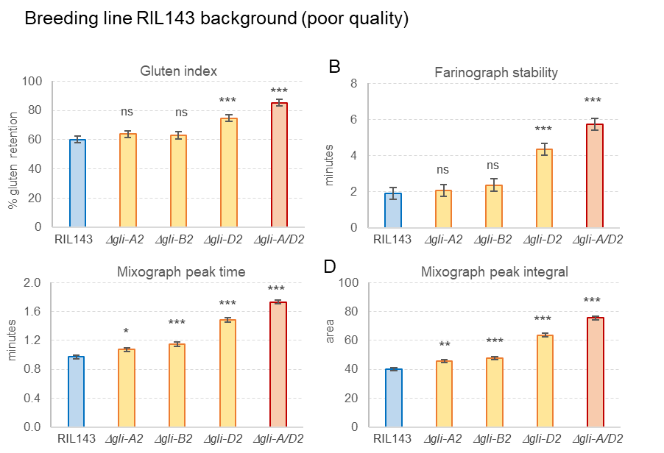
Radiation mutants without the 6D α-gliadins (Gli-D2) have stronger gluten
We used gamma radiation and fast neutrons to generate deletions in the alpha gliadins.
We found deletions for 6A (gli-A2), 6B (gli-B2)and 6D (gli-D2).
We used exome capture to estimate the size of the deletions and select the smallest ones.
We evaluated BMQ parameters for all 3 lines in replicated field trials.
Lines with the 6D (gli-D2) deletion showed significantly stronger gluten and increased loaf volume and backing scores.
Gli-D2 includes gliadins with 7 cysteines included in the gluten polymer whereas Gli-A2 and Gli-B2 have gliadins with 6 cysteines (intramolecular)
This is good news because Gli-D2 includes some of the most allergenic gliadins for celiac disease.
gli-D2 deletion produce increased gluten strength: 16% ↑ gluten index, 50% ↑ gluten strength and stability, 15% ↑ loaf volume & 80% ↑ baking score

Slide 12
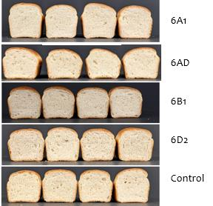
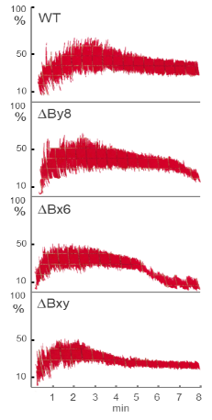
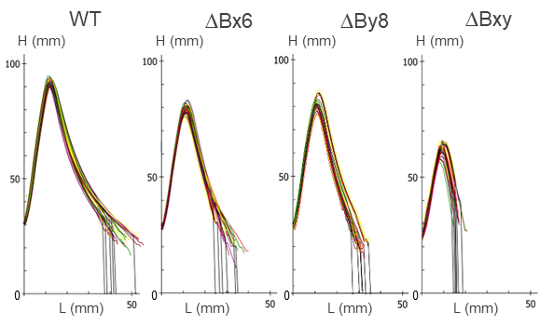
Deletion of α-gliadins from 6D increase quality
Commercial variety UC-Central Red background (good quality)
Loaf volume of lines with
α-gliadins deletions
Cen.Red Δgli-D2 Cen.Red Δgli-D2 Cen.Red Δgli-D2 Cen.Red Δgli-D2
Deletions of HMW-GS reduce gluten strength (Zhang 2020 JCS)
Mixograph Alveograph
Rottersman et al. 2025 TAG

Slide 13
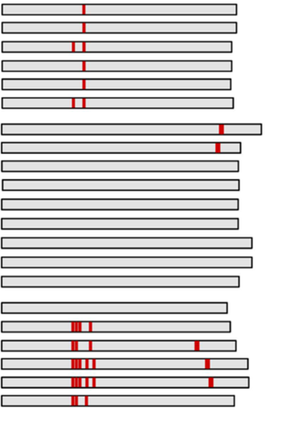
Reducing gluten allergenicity in CA wheat varieties
1A 1B 1D
6A 6B 6D
γωGli
/ LMW-Glu
αGli
α gliadin genes
red bars are celiac epitopes
γωGli
6A
6B
6D
HMW-Glu
Gli-D2 deletion has no negative effects on grain yield or grain protein content
We have identified small deletions in all loci. However, the ones in red have a few allergenic genes outside the deletion that we are currently targeting by CRISPR
Notes:
16% increase gluten index, 50% more gluten strength and stability, 15% improved loaf volume and 80% higher baking score.

Slide 14
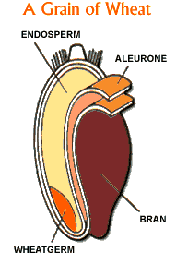
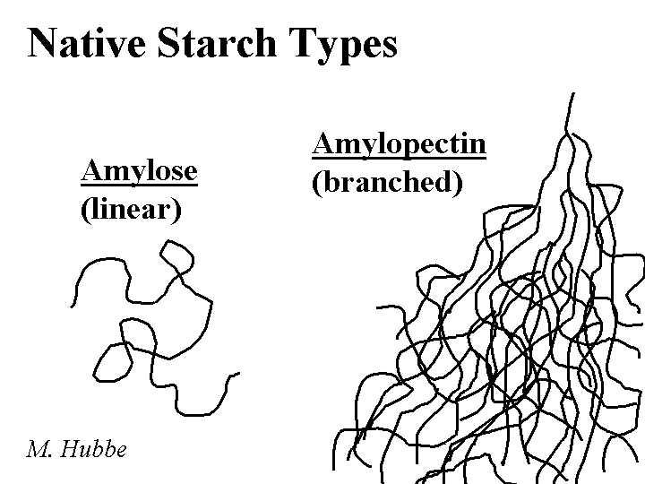

Starch composition and dietary fiber

Slide 15
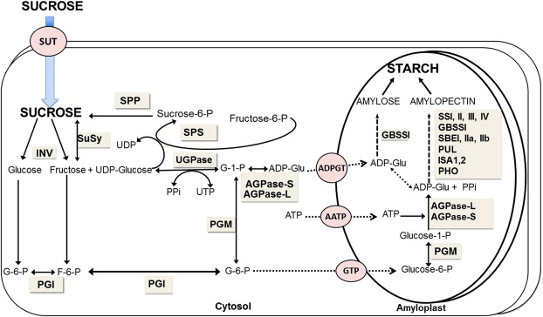

Engineering the starch biosynthetic pathway
Most of the endosperm is starch (linear, more difficult to digest).
On average 25% of the starch is amylose and 75% amylopectin (branched, easier to digest).
Null mutations in genes encoding Granule-bound starch synthase I (GBSSI) result in amylose-free starch endosperm, and good Udon noodle quality.
Mutations in the genes encoding the Starch branching enzyme IIa and IIb (SBEIIa and SBEIIb) result in higher amylose.
Amylose is not readily digested in the small intestine and functions as dietary fiber.
We can increase fiber in refined flour by knocking out multiple SBEIIa and SBEIIb genes!
Notes:
granule-bound starch synthase I (GBSSI)

Slide 16


Increasing Resistant Starch in durum wheat
Amylopectin
SbeII
Amylose = Resistant starch
4 mutations
sbeIIa + sbeIIb mutants in tetraploid wheat Kronos
A
B
Found mutations in SbeIIa & SbeIIb
Crossed & combined SbeIIa + SbeIIb
Transferred to hexaploid wheat
% resistant starch
SbeIIa
SbeIIb
J of Pl. Reg. 2014
mut-A mut-B mutAB Control
mut-A mut-B mutAB Control
sbeIIa + sbeIIb mutants in hexaploid wheat Lassik
5 mutations
A
B
D
We released three high fiber wheat varieties
UC-Lassik-RS
UC-Patwin-RS
UC –Desert King-RS
SbeIIa
SbeIIb
Crop Sci. 2016

Slide 17

Improving water absorption with partial RS mutants
Resistant Starch
5 mutations
Partial mutant
2 mutations
Water absorption is an important quality parameter for both
Breadmaking quality
Tortilla quality
Using sbeII mutant combinations, we were able to modulate water absorption
A
B
D
A
B
D
SbeIIa
SbeIIa
SbeIIb
SbeIIb
Using the single B genome mutation we can reach 70% water absorption
This is higher than what is normally found in common wheat
Notes:
Working with mi Rancho

Slide 18
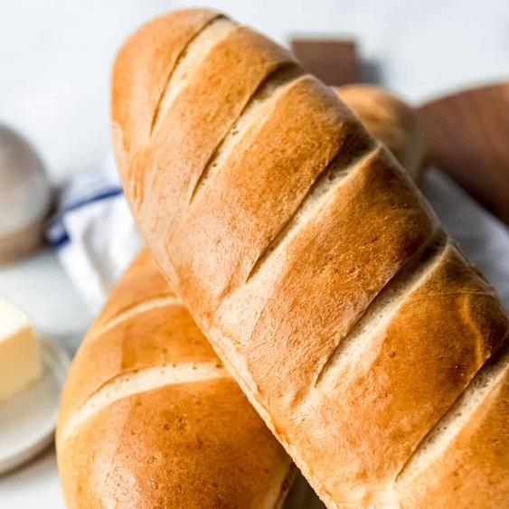
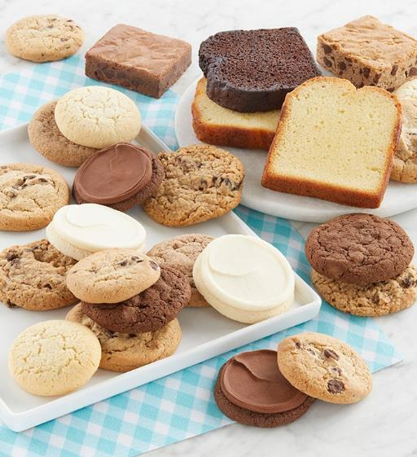
Grain texture (hardness)
Hard wheats - bread
Soft wheats – cookies & cakes

Slide 19
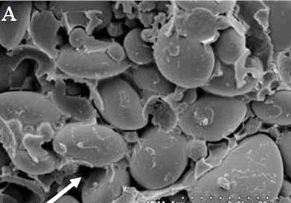
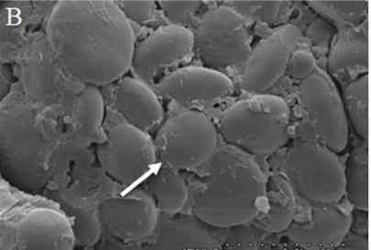
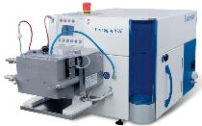
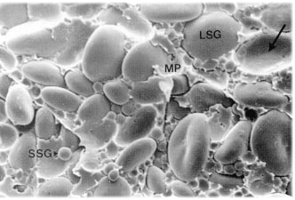
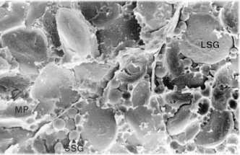
Endosperm texture is a determinant of milling and end-product quality
Soft wheat
Hard wheat
Before milling
A. Soft wheat: lose binding of starch granules to protein matrix
B. Hard wheat: Tight binding of starch granules to protein matrix
Soft wheat
Hard wheat
After milling
A. Soft wheat: most starch granules remain intact
B. Hard wheat: a large proportion of starch granules are broken
Intact starch grains
Broken starch grains
Water absorption
Water absorption affects:
Loaf volume
Bread yield and attributes
Fermentation (proofing)
Shelf-life
Measured with a farinograph
A. Soft wheat: intact starch granules absorb 0.5 its weight of water
B. Hard wheat: broken starch grains absorb 3-4 fold its weight of water (6-8 fold ↑)
Notes:
What is proofing in baking?
In bread baking, the word proofing most commonly refers to the final rise dough undergoes, which takes place after being shaped into a loaf, and before it is baked. In practice, however, the words proof and fermentation are sometimes used interchangeably.

Slide 20
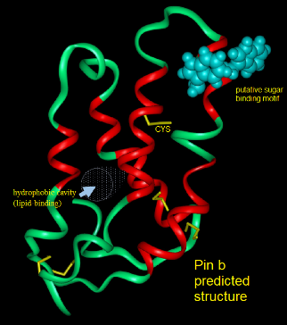
Puroindolin genes (PINA & PINB) are the major determinants of grain hardness
Functional PINA or PINB confer grain softness (dominant trait).
PINA and PINB are deleted in the A and B genome of tetraploid and hexaploid wheat.
This explain why durum wheats are all hard (“duros” = durum wheat).
Diploid wheat T. monococcum carries active PINA & PINB in the A genome
Functional Puroindolin on chromosome arm 5DS confer softness in common wheat.
Chr 5DS
PinA
PinB
mwg920
10 cM
abg705
tam53
Dor5
abg395
Grain hardness can be modulated by different PIN combinations
Pina-D1 + Pinb-D1 + TmPina-A1 + TmPinb-A1 Extra soft (++)
Pina-D1 + Pinb-D1 Soft (+)
Pina-D1 + mut pinb (Gly > Ser) Hard (-)
del. + Pinb-D1 Hard (-)
del. + del. Extra hard (--)
cdo749
wg541
Tranquilli et al. 2002
Crop Sci. 42:1812–1817
Soft
Hard
Grain texture → starch damage during milling → water absorption of flour → loaf volume

Slide 21
Grain carotenoid pigments

Slide 22
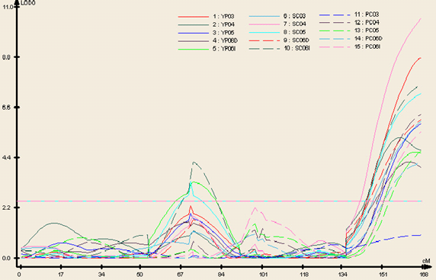
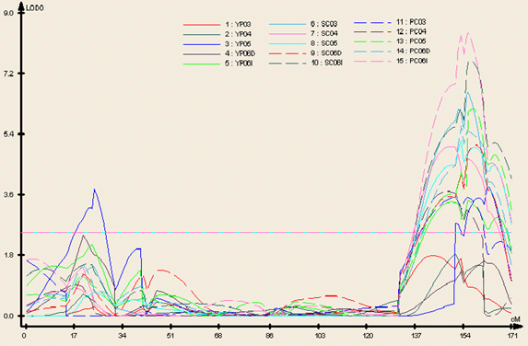
Mapping genes affecting pasta quality
7A
UC1113 x Kofa
Zhang et al. 2008
TAG 117:1361
0.0
gwm635
Yellow pigment in Semolina & Pasta
15.0
barc70, wmc479
7A
UC1113 +
5A
5B
6B
28.6
wmc168
0.0
wmc350
0.0
gwm234
0.0
ksm45
3.5
gwm47
15.1
wmc149
0.6
gwm613
55.4
barc219
26.0
barc101, gwm120
41.2
barc74, gwm335
72.6
barc282, cfa2174
51.1
gwm371
46.1
barc14
73.1
BQ170462
51.4
barc117, barc358,
gwm293, gwm304
53.2
barc331
53.4
barc101
74.3
barc174
54.5
dupw205
55.6
wmc398
94.9
barc1034
55.8
wg341b
66.5
gwm499
59.8
barc198
BE471272
73.3
BE495277
60.4
BE604119, wmc105
99.7
barc180,
BQ169669
103.2
barc1182
76.4
barc354
101.7
wmc596
117.9
barc151
100.3
gwm408
79.5
barc79
103.1
wmc603
163.2
BG607308
121.0
barc142
97.4
wg341a
126.3
wmc488
166.1
barc355, cfa2185
129.2
wmc160
115.5
gwm219
137.8
gwm276
172.8
wmc110
129.9
barc232
131.2
wmc621
191.8
wmc577
145.1
wmc28
139.0
barc134
170.6
cfa2293, wmc116
193.5
gwm126, gwm179
168.8
CD373602
171.2
cfd6
PSY-A1
197.7
wmc524, wmc727
173.2
gwm497
205.9
cfa2149
180.5
gwm118
7B
0.0
barc1005, barc1068
9.7
wmc323, wmc606
Yellow pigment in Semolina & Pasta
10.9
barc279
6A
20.8
gwm537
23.1
gwm400
7B
Kofa +
Yellow pigment Semolina color
Pasta color
Protein content
Gluten index
SDS sedimentation
Mix. Time to peak
Mix. Peak height
Mix. Peak width
Mix. end width
Mix end height
Cooking firmness
38.7
wmc182
0.0
Gli-A2
53.1
gwm46
4.0
barc23
53.9
barc23
12.3
CD491758
59.2
barc72
62.5
gwm297
63.3
barc267, wmc476,
wmc662
36.2
barc146
70.8
gwm333
40.0
gwm132
80.6
BF474379
43.7
barc118
82.3
barc176
47.4
barc107
85.3
wmc396
49.2
barc1165
108.4
barc278
57.4
wmc256, barc113
119.9
BE498985
67.1
wmc553, barc204, wmc201
124.5
wmc195
68.8
gwm570
75.6
wmc179
PSY-B1
77.9
barc353
92.6
gwm169
98.2
BE483091
163.4
wmc311
101.7
gwm427, gwm617,
wmc580
182.2
wmc276
PSY-B1 is a novel hybrid allele from conversion between PSY-B1/ A1
183.4
wmc581, wmc273, cfa2040
125.5
dupw167
184.6
barc1073
126.4
barc104
190.5
barc340
127.7
cfd2
191.0
gwm146, Psy-B1
199.3
cfa2257
Notes:
We measured multiple traits but I want to focus on color as an example.
Confirmed Psy-B1 by sequencing mutants without yellow pigment

Slide 23
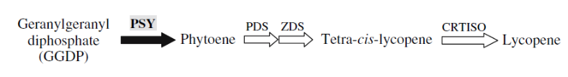
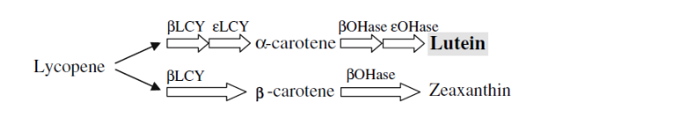
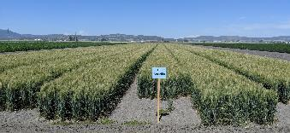
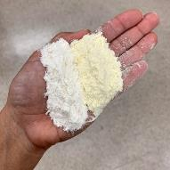
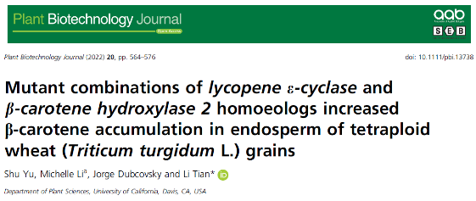
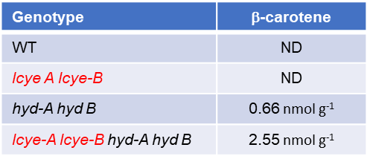
Applications of this information
We demonstrated that mutations in the Phytoene Synthase 1 (PSY1) was responsible for the differences in yellow pigments (Zhang et al. 2008 TAG 116:635-645)
PSY1 is a critical enzyme in the carotenoid biosynthetic pathway
PSY
X
X
UC-Amarillo
Mutations in PSY-A1, PSY-B1, & PSY-D1 are responsible for wheat white flour
We have restored PSY-D1 and released the first yellow flour wheat variety UC-Amarillo
We are collaborating with Professor Li Tian at UCD to increase β-carotene in wheat

Slide 24
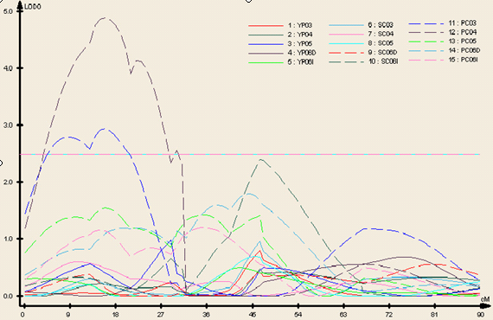
QTL for pasta color but not semolina color
3A
1B
2A
2B
0.0
wmc532
0.0
wmc154
8.8
gwm369
1A
0.0
wmc382
17.3
cfa2201
28.2
cfa2163, wmc50
0.0
gwm374
21.4
gwm429
29.5
wmc505
0.0
Bla
15.4
wmc406
23.7
wmc597, BQ168780
40.6
barc356, barc359,
wmc625
23.8
wmc95
19.3
ksuE18, wmc193
22.8
gwm296
27.2
BMl40538
20.8
barc8
cnl158
41.3
cfa2234, gwm666
24.4
cfa2158, wmc329
28.2
gwm413
55.2
wmc296
37.7
51.4
ksm28
39.1
wmc24
34.4
gwm273
55.9
gwm122
40.2
wmc35
47.5
barc148
35.1
wmc626
barc309
44.1
gwm410
64.4
wmc428
40.2
wmc85
65.8
BF293500
73.2
wg983
45.3
BE500714
66.6
gwm275
79.7
75.2
barc83
46.4
barc240
70.0
gwm515
76.4
gwm135
47.1
BE443797
71.3
gwm249
87.0
BM140362
60.5
barc302
79.0
barc220, gwm71
89.3
wmc312
63.3
barc181
80.2
wmc401
91.6
cfa2129
82.6
Glu-B1
88.5
gwm328
96.1
wmc167
130.9
cfa2193
113.3
dupw38
84.3
cfa2129
96.8
wmc361
113.9
BE443588
98.6
psr162
103.7
barc159
118.0
barc213, cfa2147,
cfa2219, gwm497,
wmc716
155.9
cdo393
barc80, wg241,
wmc728
145.5
cfd50
144.4
162.6
gdm93, gwm526
Yellow pigment Semolina color
Pasta color
Protein content
Gluten index
SDS sedimentation
Mix. Time to peak
Mix. Peak height
Mix. Peak width
Mix. end width
Mix end height
Cooking firmness
145.6
ksm176
3B
4A
4B
0.0
gwm389
0.0
gwm165
0.0
wmc617
7.3
barc147
2.3
gwm192
13.2
Lpx-B1.1
13.0
gwm493, BF493133
18.3
Lpx-A3
22.2
BE446304
Yellow pigment in Pasta ONLY
22.0
cfd79
wmc617
28.9
ksm62, wmc48, wmc89
34.8
ksm45
28.1
dupw4, ksm29
37.0
gwm113
43.4
wmc43
44.2
barc170
38.2
barc337
46.2
gwm265
39.9
gwm540, BE443190, BE443253
107.5
gwm285, wmc625,
barc73
49.8
wmc258
112.8
ksm151
57.8
48.9
gwm495
Five year-location data
Lpx-B1.1
114.2
gwm66
56.0
gwm192, wmc657, gwm165
116.3
cfa2134
78.7
wmc718
74.3
cfd39
119.8
BQ159467
99.3
barc135
136.9
barc164
103.1
wmc262
wmc47
gwm247, gwm547,
psr454
105.4
barc343
98.2
179.4
121.4
barc78
180.0
cnl62, gwm181
122.6
barc327
190.0
gwm114
124.4
psr573.1
126.2
wmc219
127.4
psr573.2, wmc722
128.6
barc52
129.8
wmc313
Notes:
QTL only pasta color

Slide 25
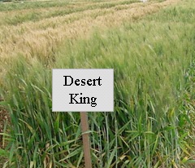
A LIPOXYGENASE deletion is associated with stable pasta color
Lipoxygenase activity
b value
Dry pasta color
We mapped differences in lipoxygenase activity and pasta color to the Lpx-B1 gene
18.0
*
48.0
*
47.0
13.5
46.0
9.0
45.0
44.0
4.5
43.0
Present
Null
42.0
Present
Null
Lpx-B1.1
Lpx-B1.1
Lipoxygenase enzymes degrade yellow pigments when activated.
Low lipoxygenase activity are associated with pasta color stability.
DK
UC1113
DK-HP
Cortez
The low level of lipoxygenease activity was
associated with a deleted copy of the Lpx-B1.1 gene.
Lpx-B1.1
We and many pasta breeding programs in the world are using these markers to develop varieties with stable pasta color

Slide 26
Questions?

